Slide 1
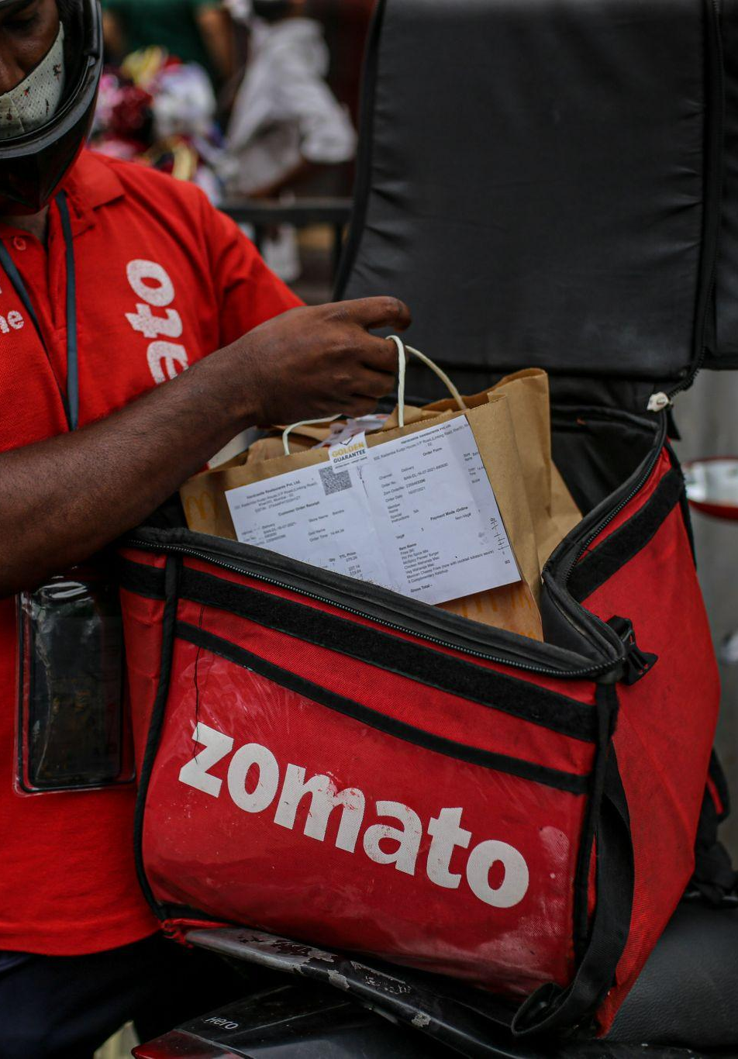
Data Visualisation on Zomato
Group Name: Snipe
Group Members:
MENG Guosheng 21431280
REN Tongyang 21407738
SHI Minting 21422443

Slide 2
TABLE OF CONTENTS
01
02
05
Current Problem
Introduction on Zomato
Limitations
03
04
Methodology
Story-telling and Outputs
Dining-in
Nightlife
Collection

Slide 3
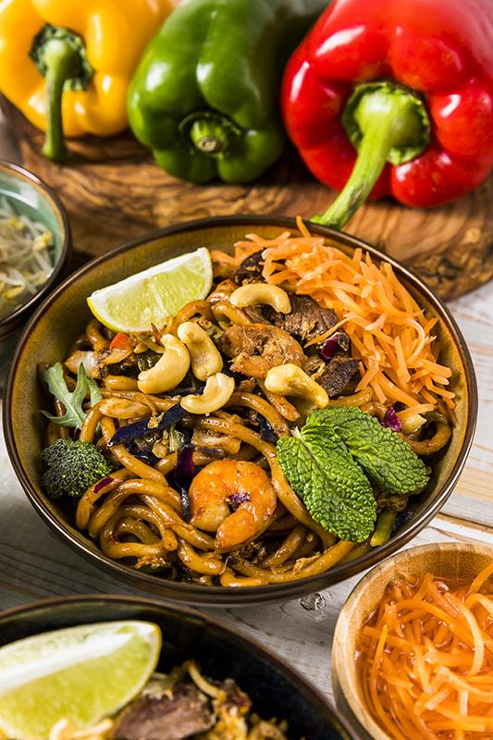
01
Current Problem

Slide 4
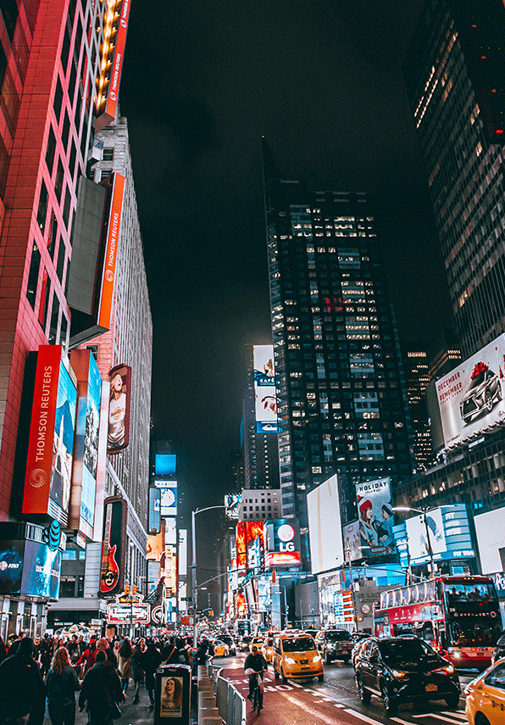
City Homogenization
Welcome to homogenized ville
-
A place just like everywhere else!
Distinctions between cities and people's perceptions of them are becoming increasingly blurred
Standardized - showing a higher trend of convergence
An obstacle in the way of helping bolster tourism industry

Slide 5
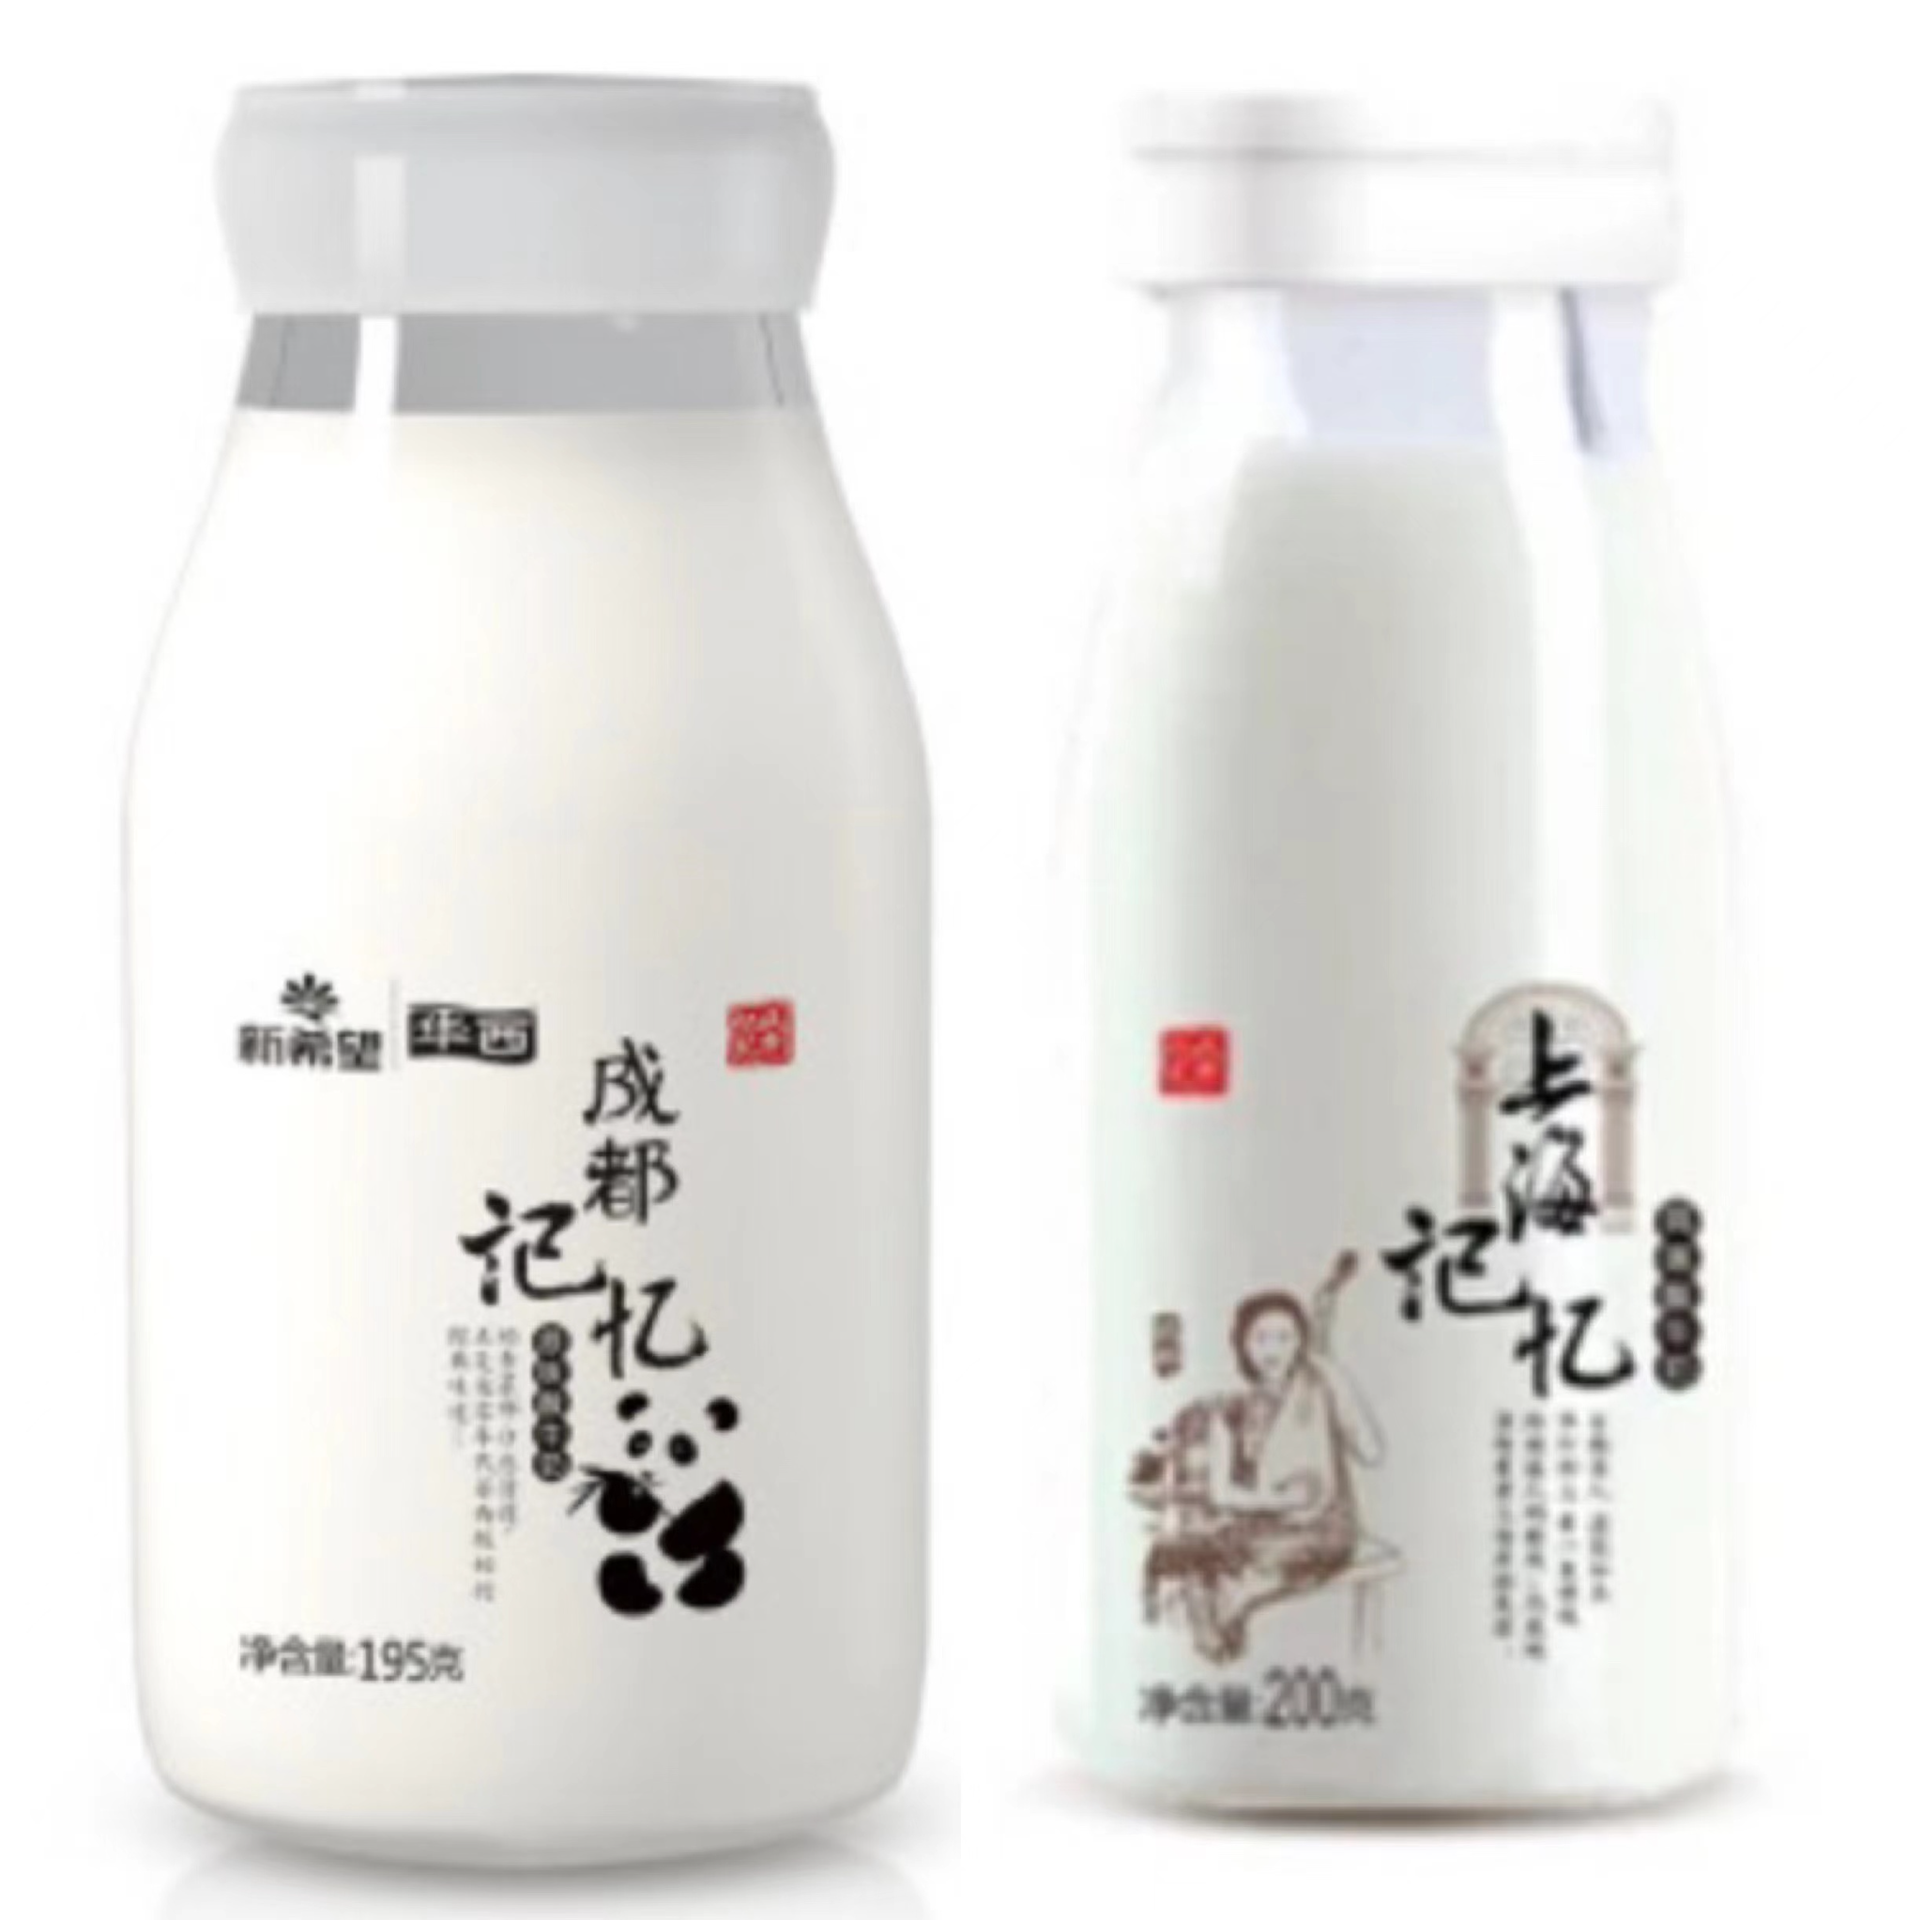
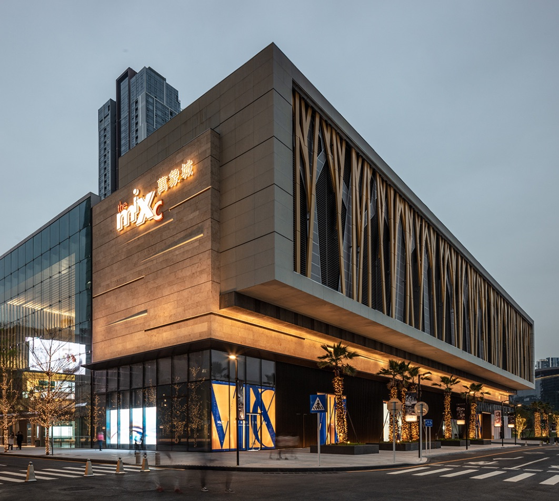
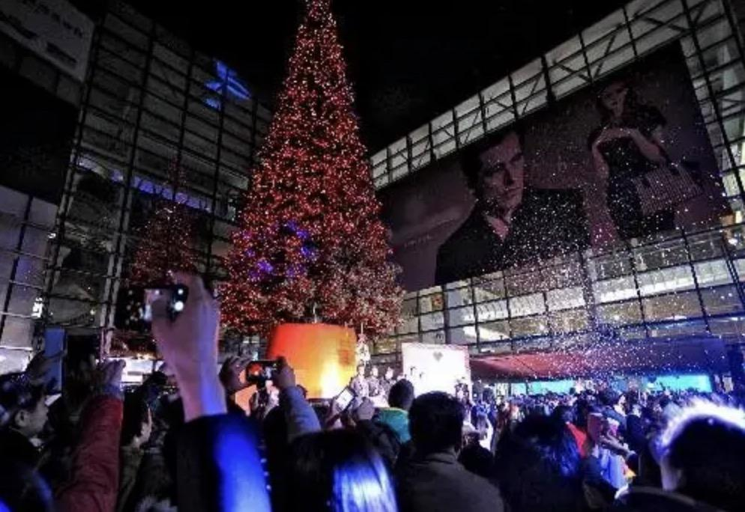
same architectural style
same food
same festival custom

Slide 6




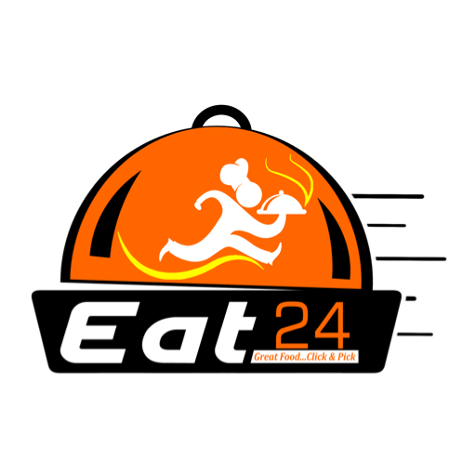
However,
for tourists who firstly come to the city…
Taste traditional authentic cuisine? - genre
Yummy food? - food quality
Recommended dishes? - user evaluation
Pay affordable price? - price
…
…

Slide 7
02
All about Zomato

Slide 8
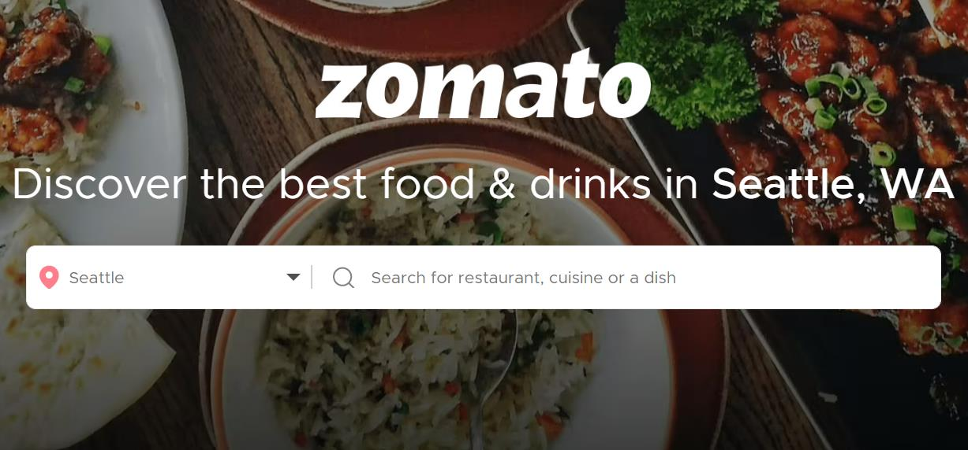
Zomato
Launched in 2008
Provide comprehensive restaurant information, menus, user evaluations
“it is not the skills that show who we [customers] are, but the choices”

Slide 9
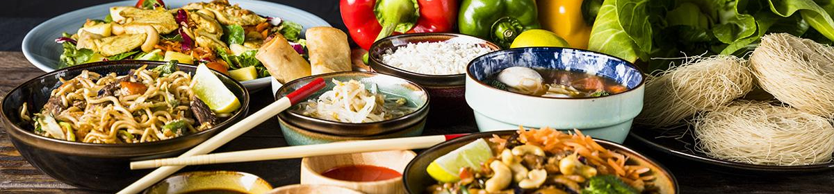
03
Methodology

Slide 10

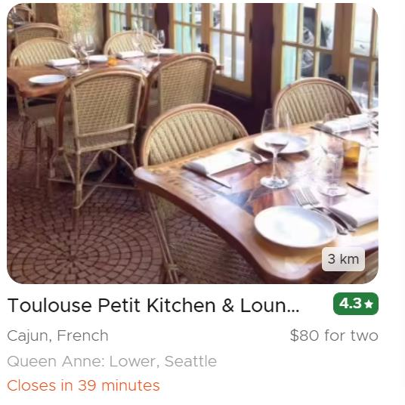
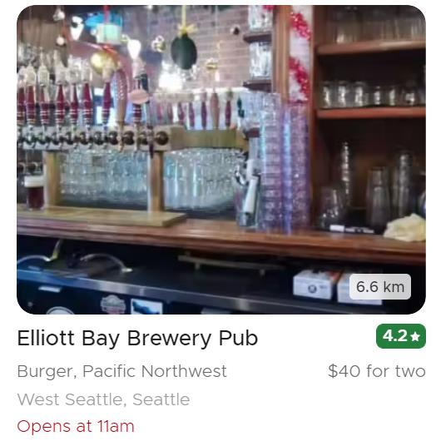
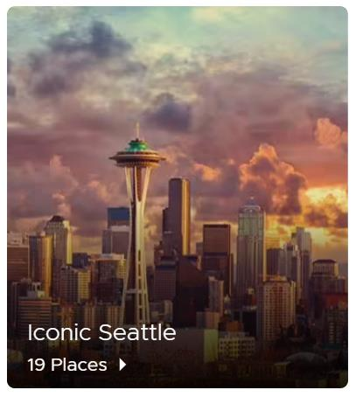
Python to scrape
Dining in
Nightlife
Collections
View the city’s favourite dining venues
Explore the city’s top night outlets
Explore curated lists of top restaurants, cafe, pubs and bars in the city

Slide 11
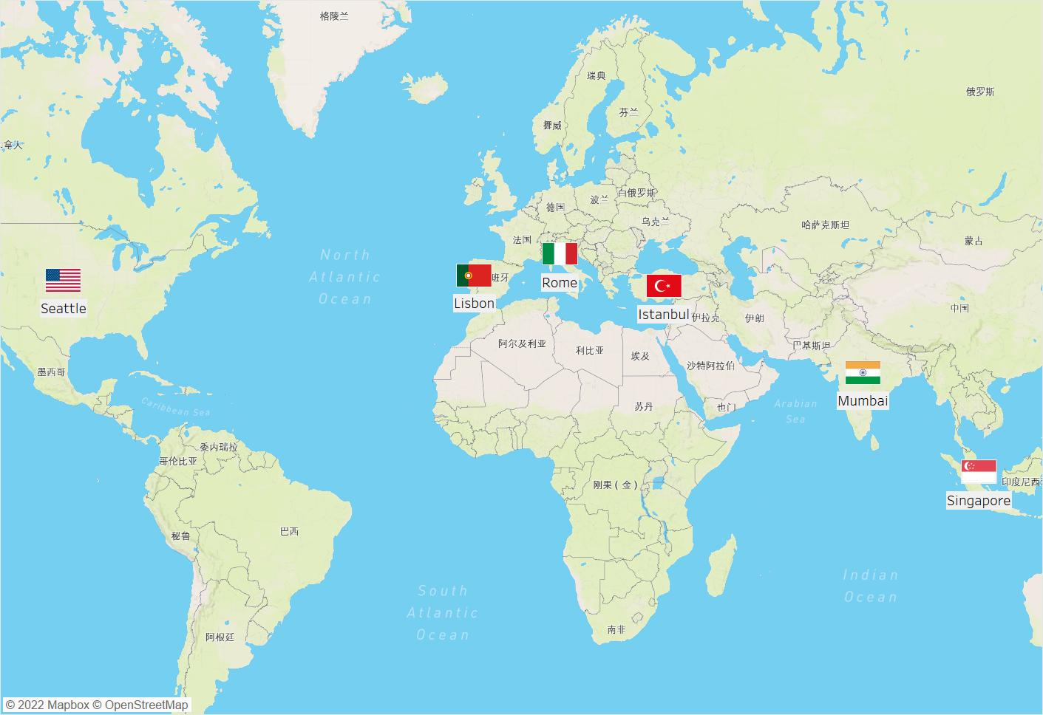
The sampled cities

Slide 12
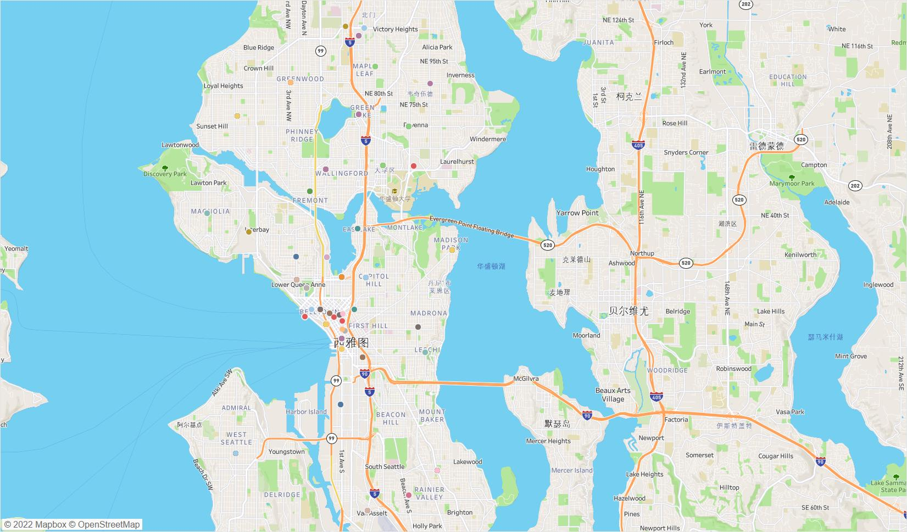
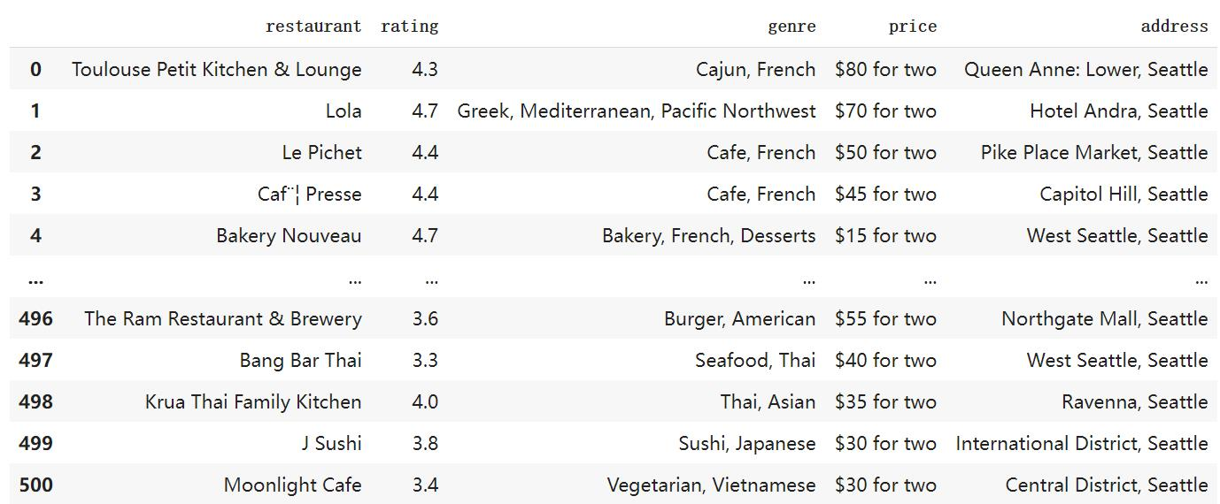
CSV
Visualization
Dataframe of the dining-in canteens in Seattle
The location of dining-in canteens in Seattle
#supported by Tableau#

Slide 13
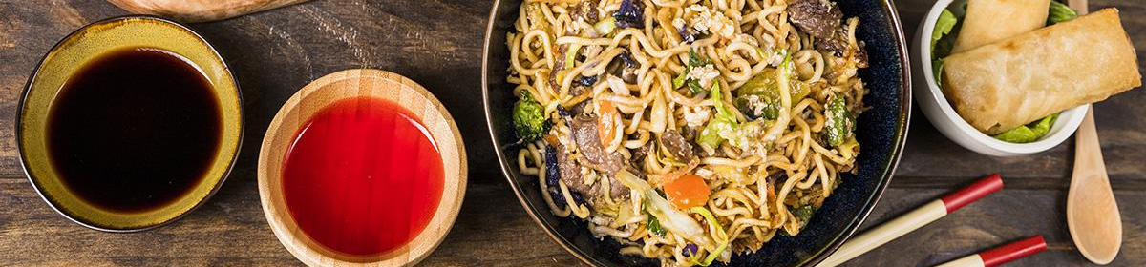
04
Storying-telling & Outputs

Slide 14
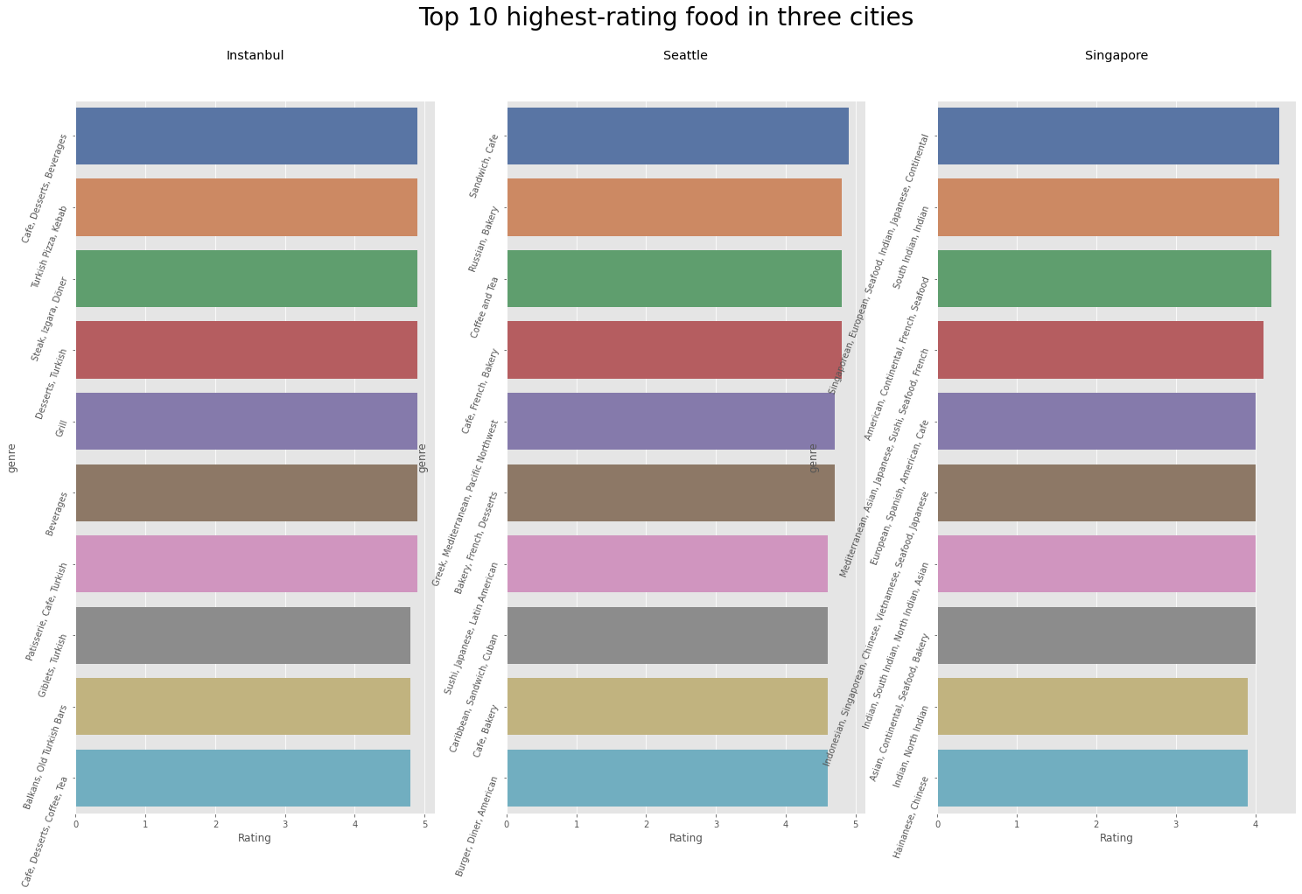
I.Dining-out Canteens
Local food seems to be welcomed by the local people…

Slide 15
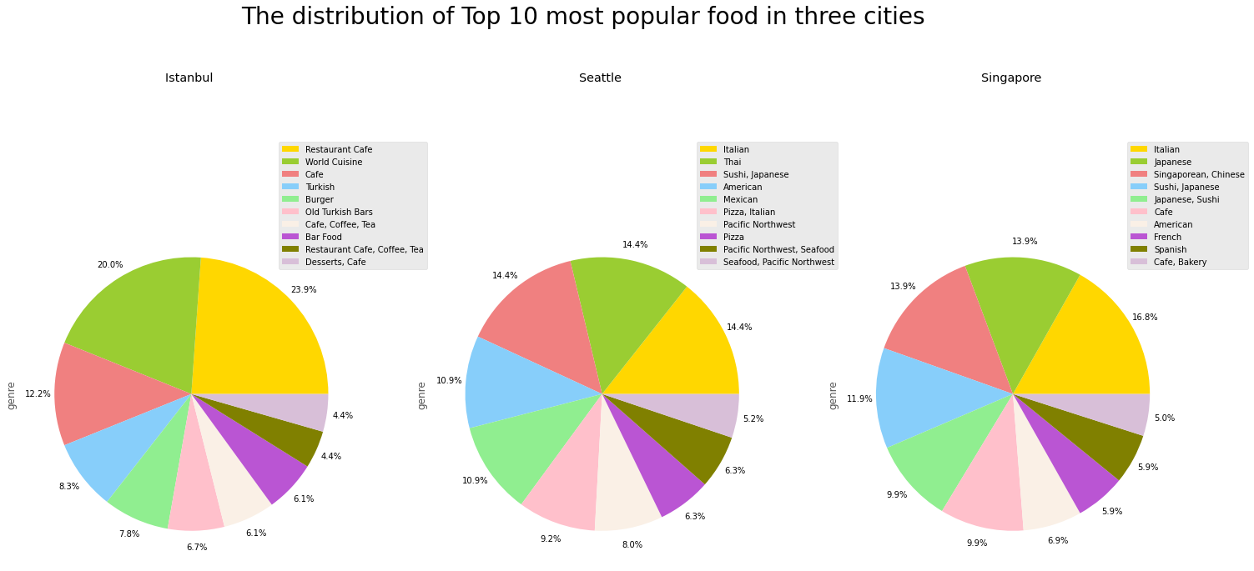
People all love Pizza around the world!!

Slide 16
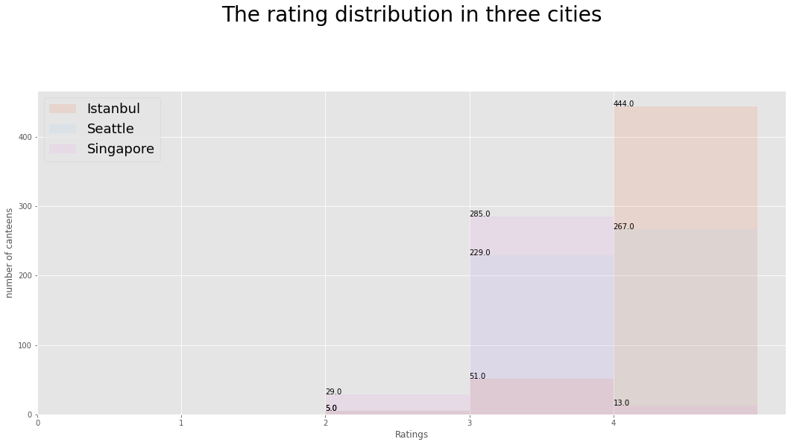
It turns out that Istanbul has the most high-rated canteens

Slide 17
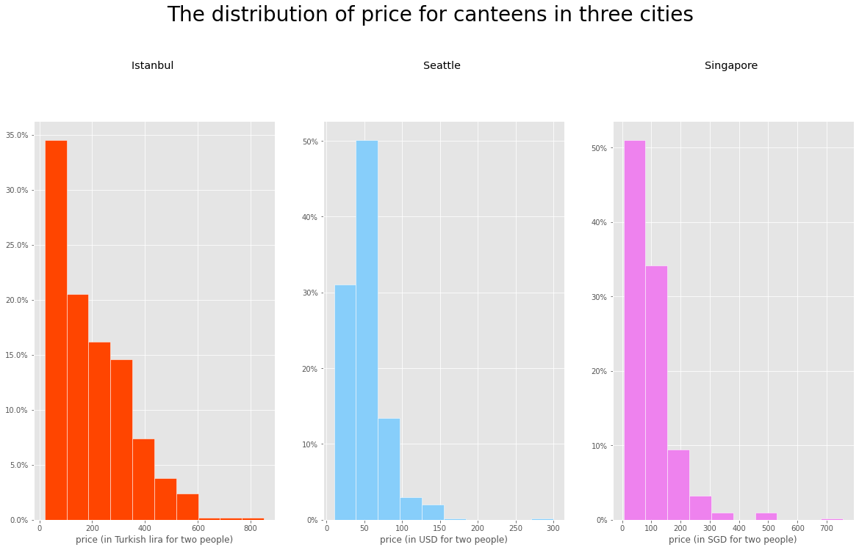
Given the exchange rate, Istanbul has lowest cost for food

Slide 18
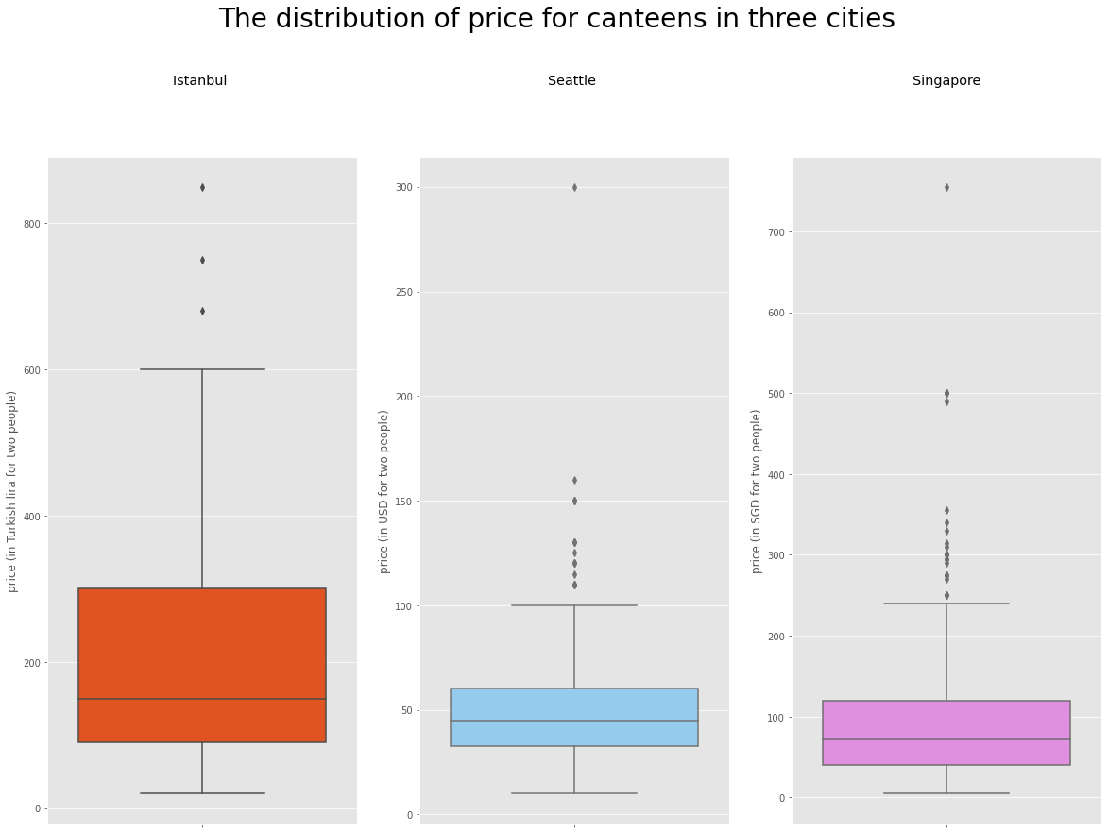
And lowest median price for a meal

Slide 19
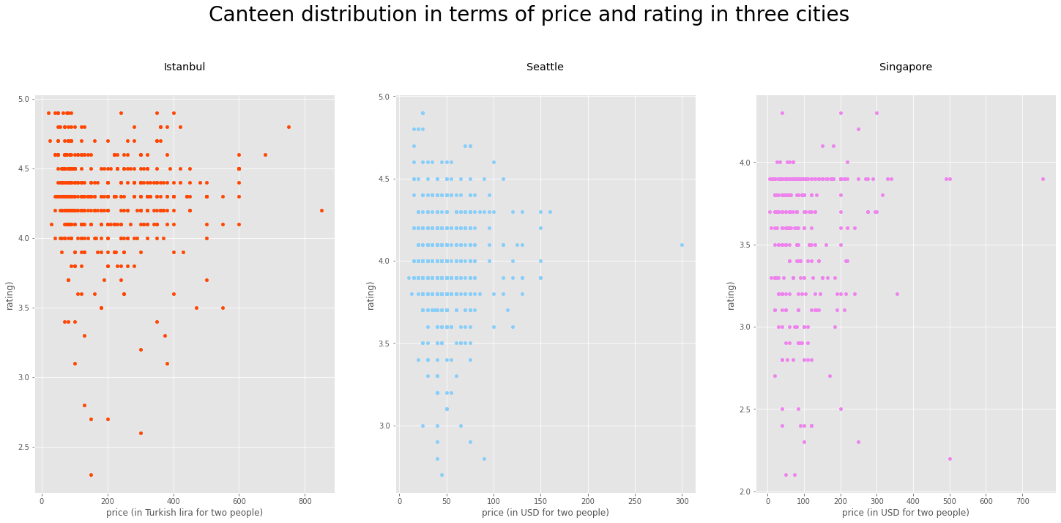
Does canteen price has a significant relationship with its rating?

Slide 20
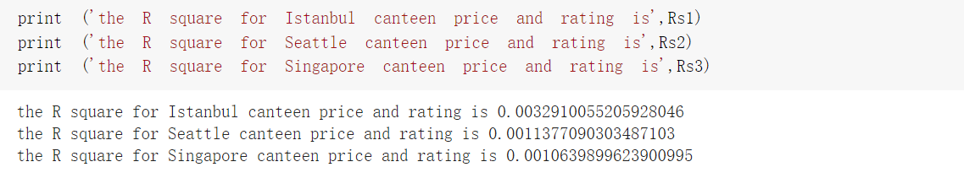
As per calculation in Python, the R square between price and rating in three cities are all less than .01 (1%)....
So, the price for each meal has NOTHING to do with its quality!!
Conclusion for the dining-in part:
Istanbul seems to be the idealist tourist destination as it is endowed with the most high-rated canteens with lowest average cost!!

Slide 21
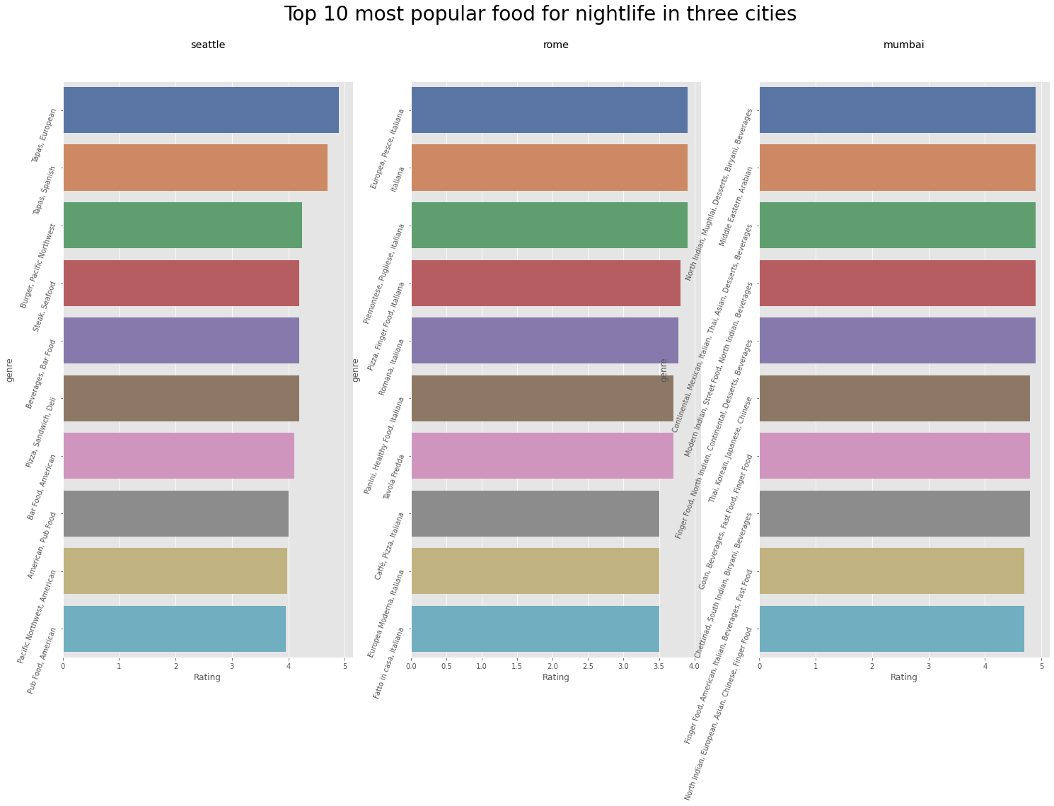
II.Nightlife Canteens
Top 10 most popular food for nightlife in three cities

Slide 22
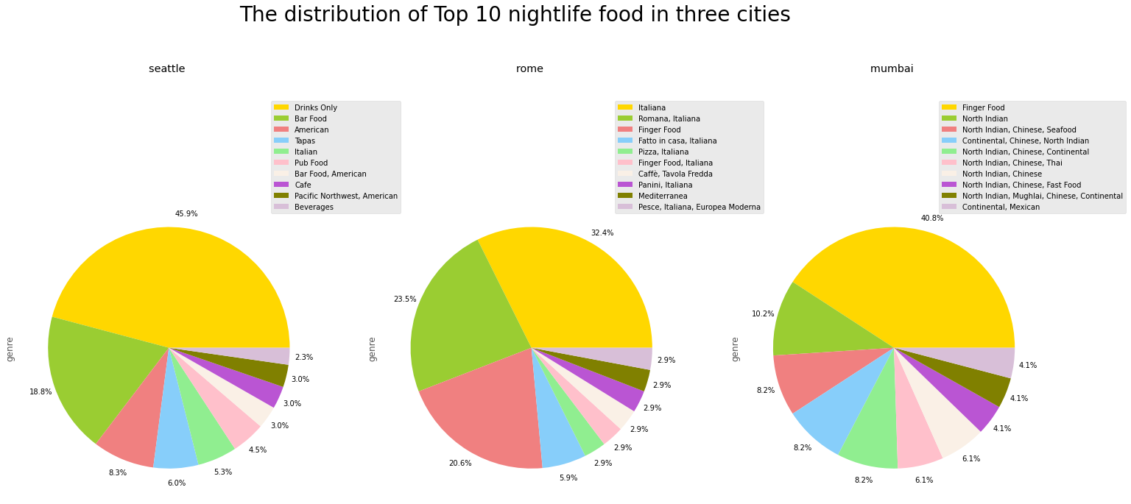
In Seattle, 45.90% of customers order drinks only during midnight.
Italians especially love the cuisine of their homeland, the figure was taken 32.40%.
40.80% of people order finger food in the midnight inn

Slide 23
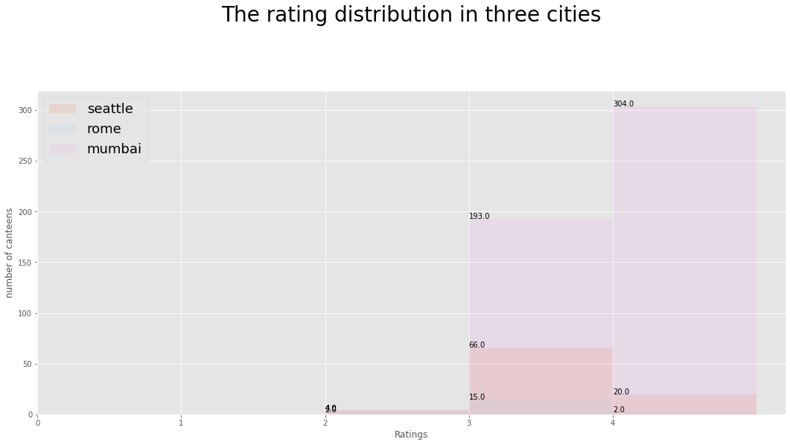
Travelers can, according to this histogram, find favored night restaurants to decide which cities they want to go to in the future.

Slide 24
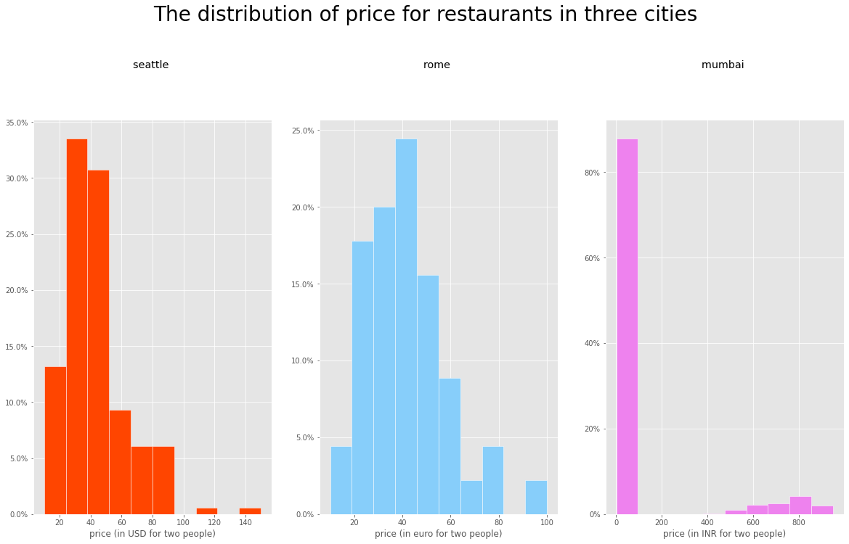
The price in Rome for night restaurants is higher than night restaurants in Seattle.

Slide 25
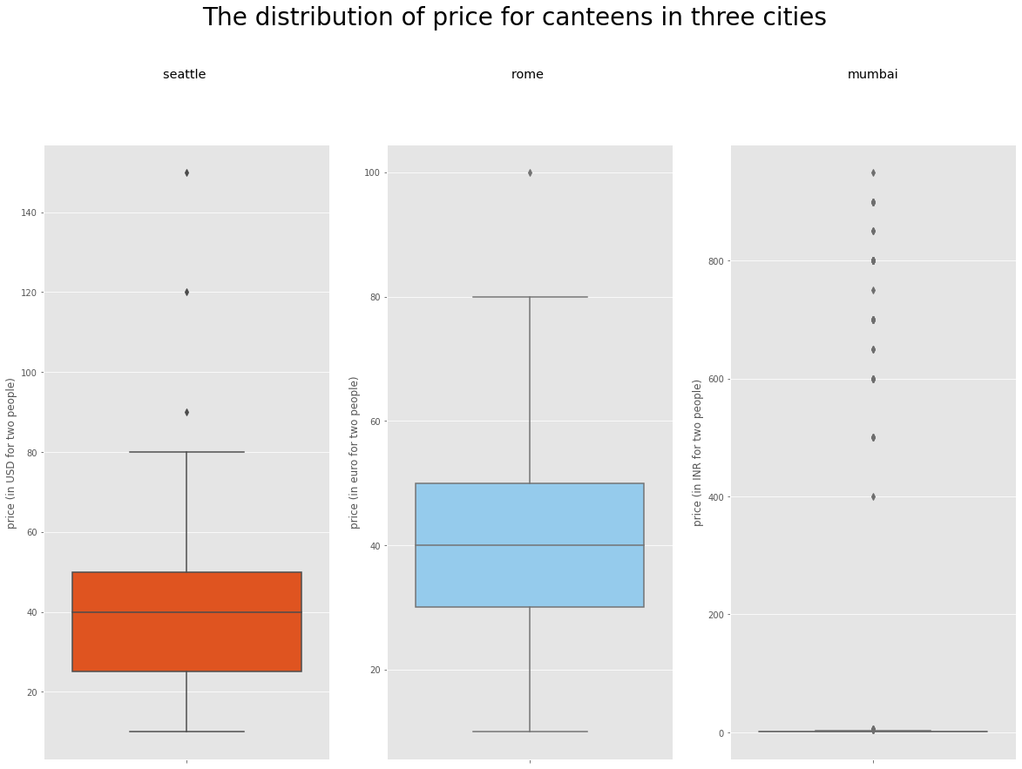
The median price for Seattle and Rome are all equal to 40.00, but due to the different currencies, it can be seen that the median price in Rome for night restaurants is higher than for night restaurants in Seattle.

Slide 26
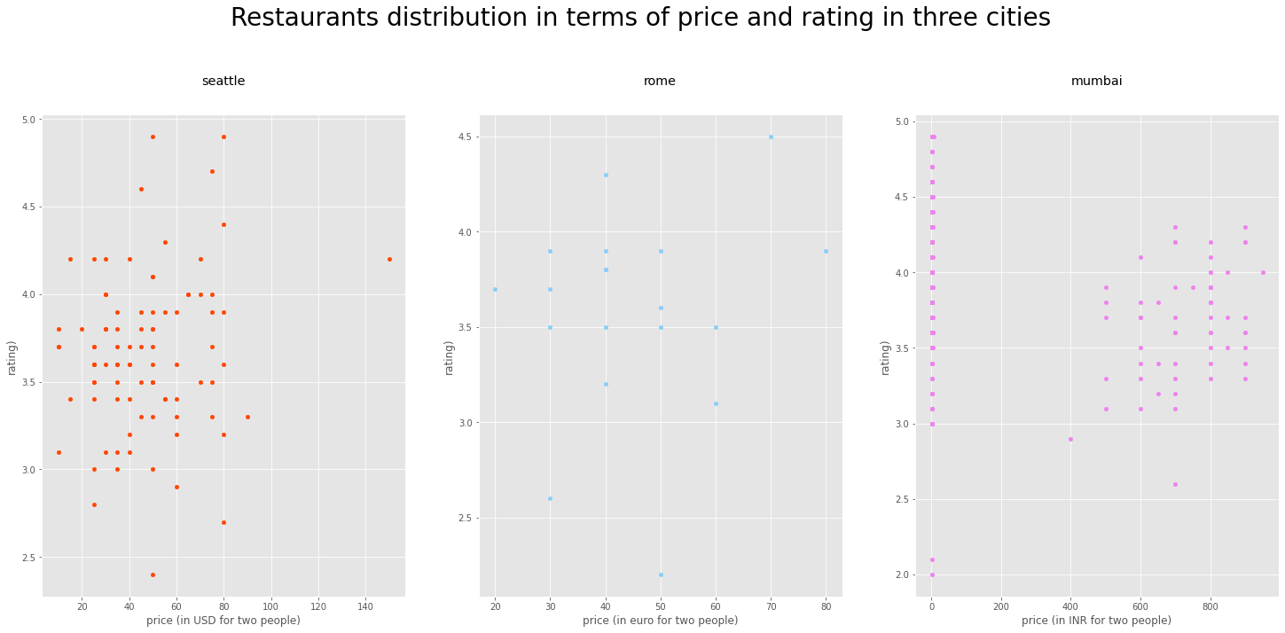
Using a dot plot to compare the relationship between prices and ratings of restaurants in the three cities

Slide 27
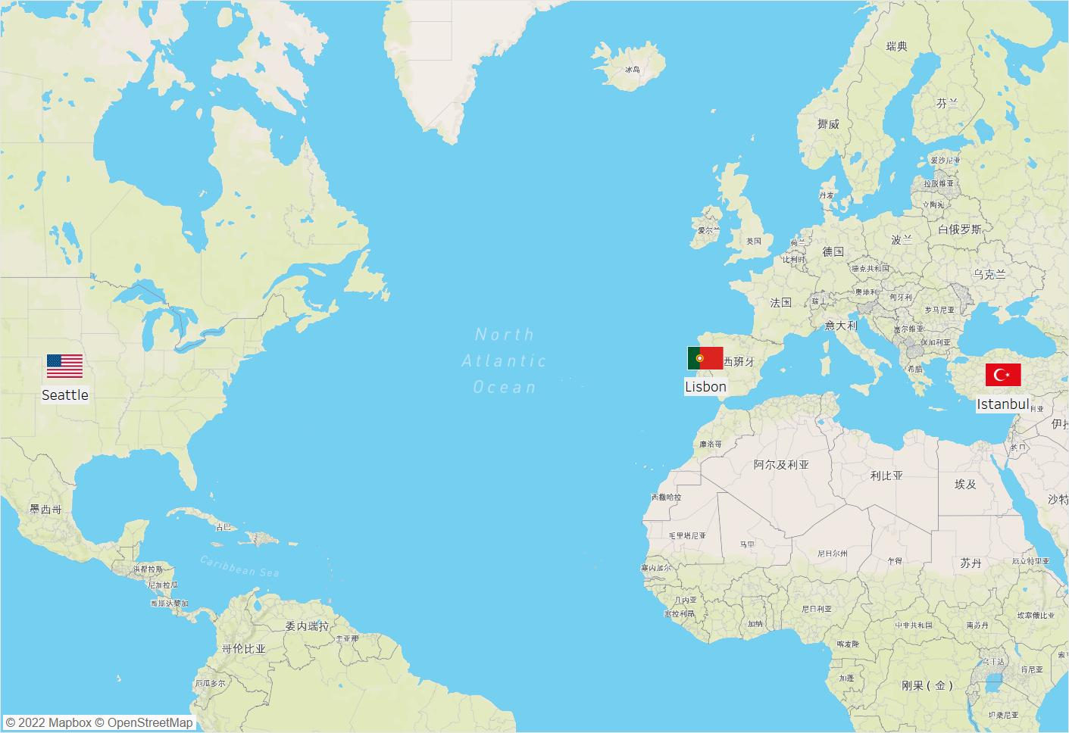
III. Collection
Seattle VS Lisbon VS Istanbul

Slide 28
Which city is the best place to chill?
COMMUNIST
RESTAURANT

Slide 29
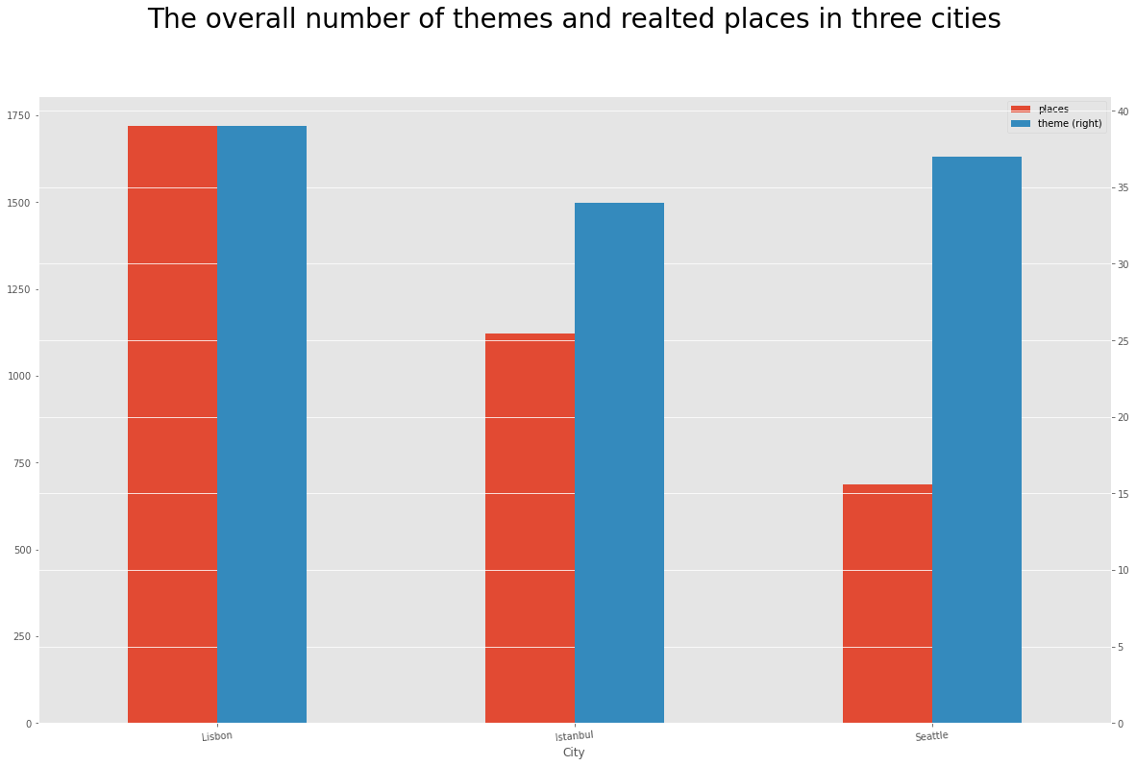
The answer is…

Slide 30
What do people in these three cities like to do?
COMMUNIST
RESTAURANT

Slide 31
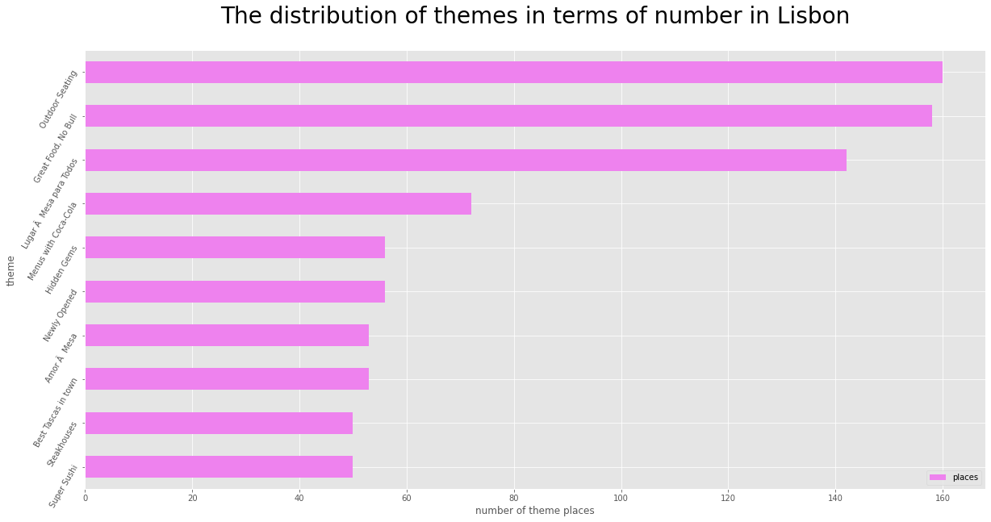


Slide 32
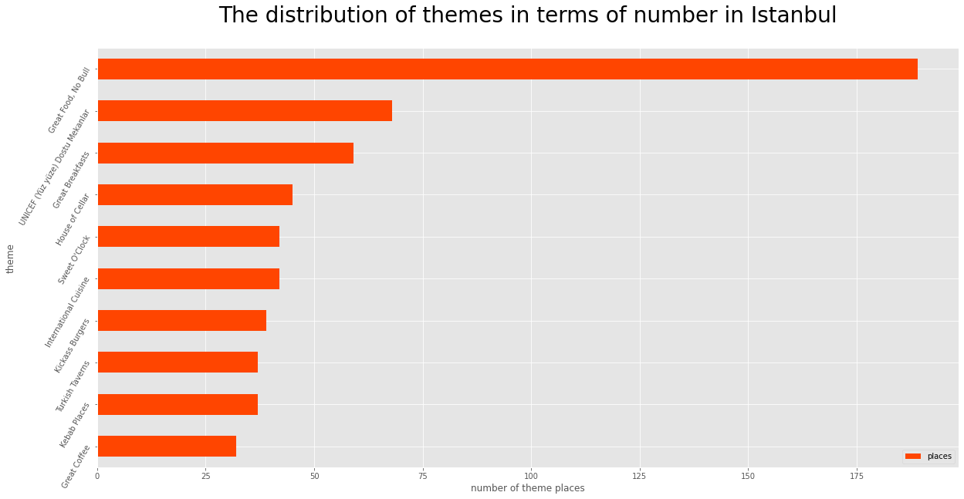


Slide 33
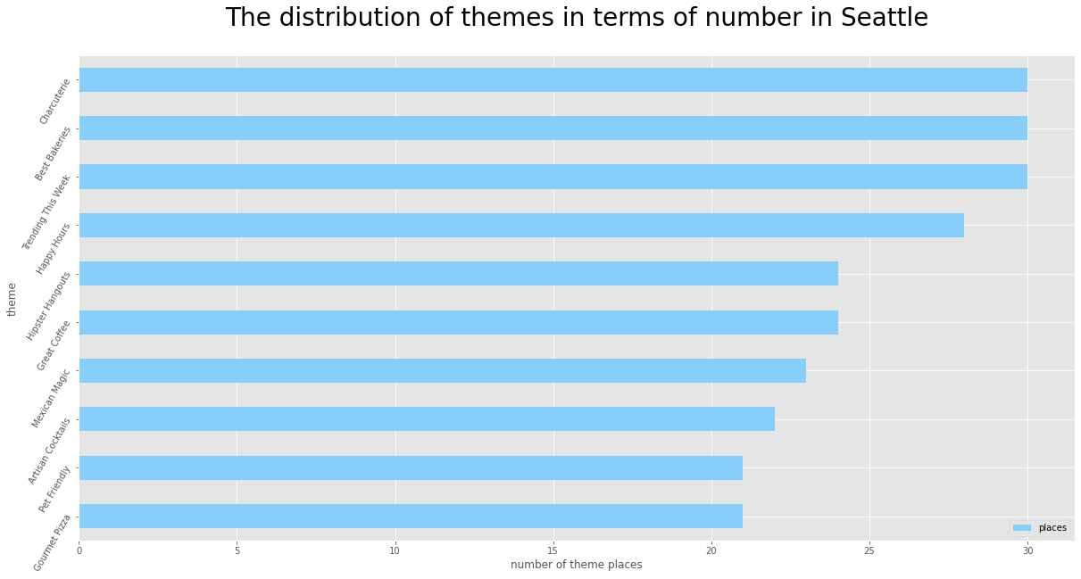


Slide 34
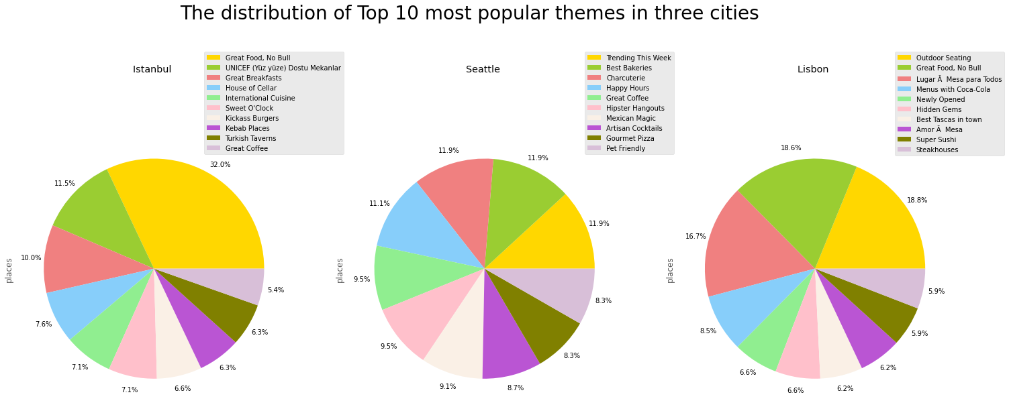
To sum up the collection part
The Portuguese are generally leading a cozy lifestyle
The Turks love the food
Work may weigh much more for Americans in their daily life

Slide 35
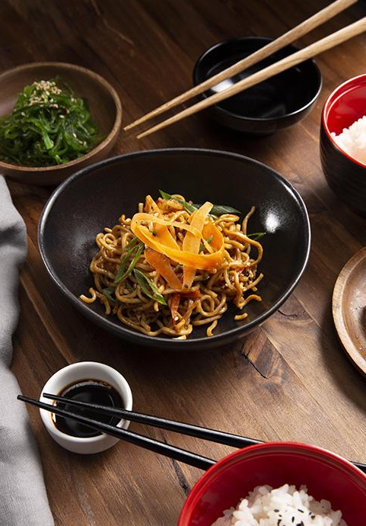
05
Limitations
The data scraped in one time may not be best for comparison due to jet lag
The findings may not be generalized due to the small sample size
The data from Zomato may not be representative as the platform’s market penetration rate is low in some countries

Slide 36
Reference
Auty, S. (1992). Consumer choice and segmentation in the restaurant industry. The Service
Industries Journal, 12, 324–339.
Matthew, S. (2019, Mar 12). Italian cuisine is world’s most popular. YouGov.
https://yougov.co.uk/topics/consumer/articles-reports/2019/03/12/italian-cuisine-worl
ds-most-popular
National Restaurant Association. (2011b). Restaurants by the numbers. Retrieved from
http://www.restaurant.org/pdfs/research/2011forecast_pfb.pdf
Panigrahi, C. M. A. (2020). A case study on Zomato–The online Foodking of India. Journal
of Management Research and Analysis, 7(1), 25-33.
Vu, H. Q., Li, G., Law, R., & Zhang, Y. (2017). Exploring tourist dining preferences based on
restaurant reviews. Journal of Travel Research, 58(1), 149–167.
https://doi.org/10.1177/0047287517744672

Slide 37
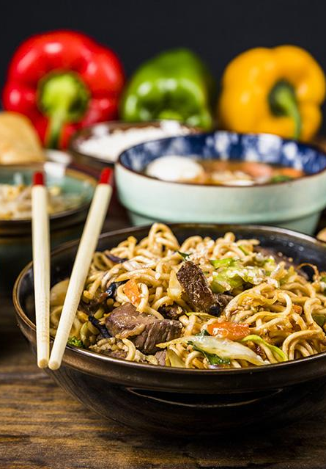
THANKS
Does anyone have any questions?
(A nope would be nicely appreciated)

